Slide 1
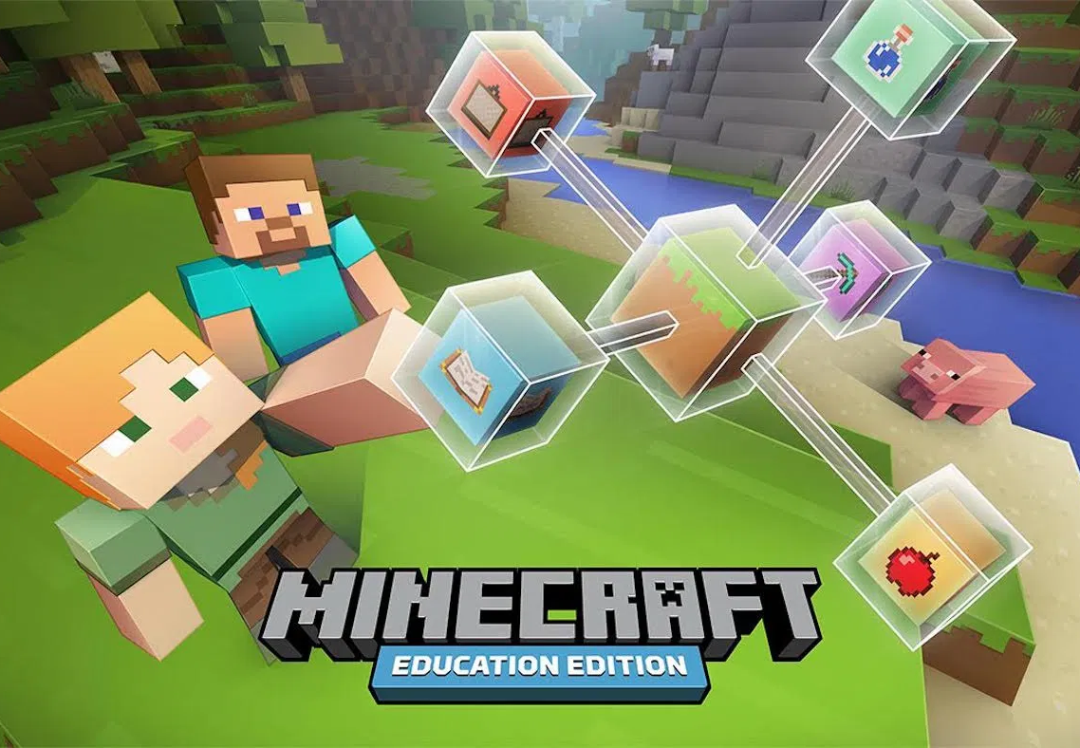
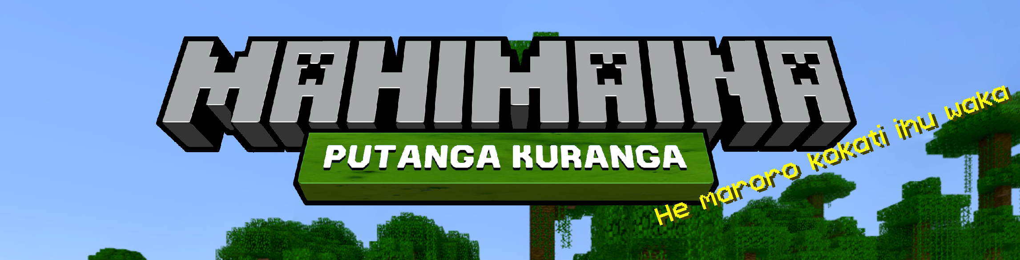
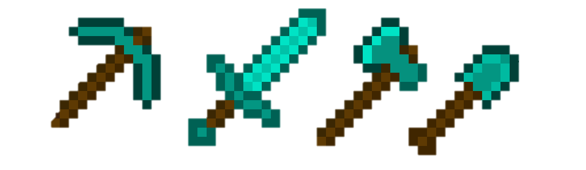
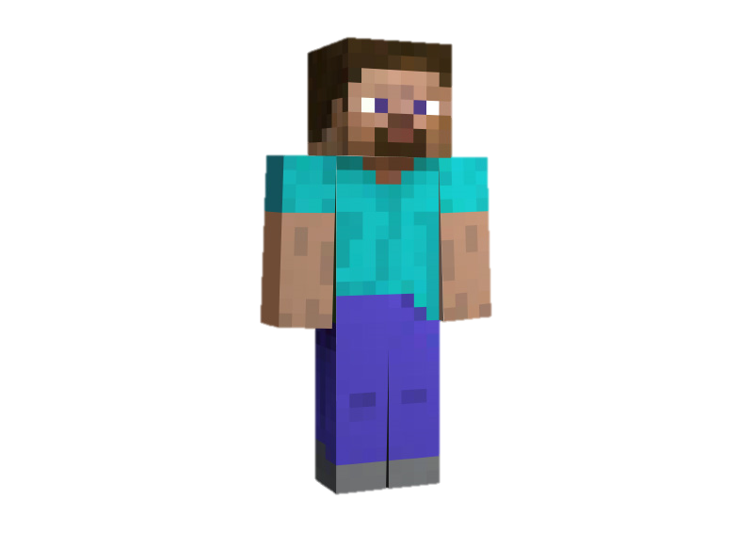
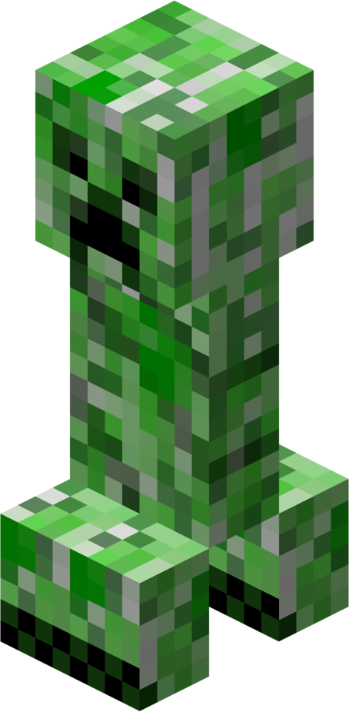
Tō Tātou Tiriti Akomanga
When using Minecraft Education Edition in class I will;
Always play in CREATIVE MODE and on PEACEFUL setting (unless my teacher asks me to play SURVIVAL)
Ensure my builds have been planned properly, especially if I am team building (use the template)
Use the CAMERA and BOOK & QUILL tools to document my building
Provide evidence of my creations to my teacher
Stay on task, not get distracted and not use chat commands to change my world
Not GRIEF my world or others (purposely destroy creations or spawn mobs/animals)
Do my best to help others and work in a cooperative way
I understand that using Minecraft Education in class is a privilege and that breaking the treaty will result in me losing that privilege for a time.

Slide 2
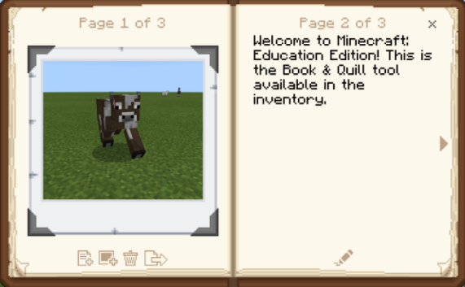
Tō Tātou Tiriti Akomanga
Hainatanga

